Slide 1
STRUCTURE OF THE EYE, EAR AND SKIN

Slide 2
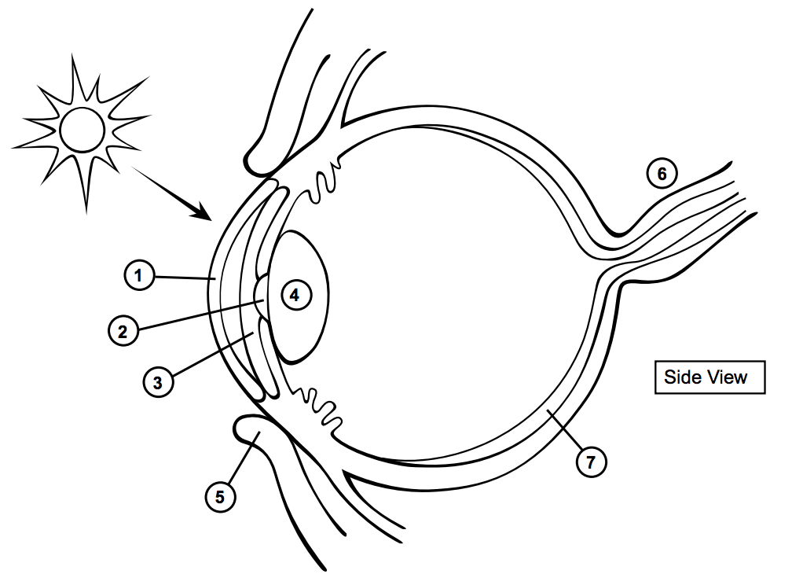

Slide 3
DETECTING LIGHT
Cornea
Bends light as it enters.
Iris
Controls how much light enters pupil by dilating or contracting.
Lens
Focuses light onto the retina

Slide 4
Retina
Uses photoreceptors to detect the image we are seeing. Two types –rods (night vision) and cones (colour and day vision)
Changes energy of light rays into nerve impulses.

Slide 5
Optic nerve
Impulse to the brain

Slide 6
HOW DO WE SEE PARAGRAPH
Light enters via cornea. It bends the light directing it to the pupil. The iris controls the pupil(contract or dilate) causing light to enter and pass through the lens. The lens focuses the light onto the retina. The retina contains photoreceptors (rods- night and cones- colour and day.) Converts the light ray into an impulse. This impulse travels to the brain by the optic nerve.

Slide 7
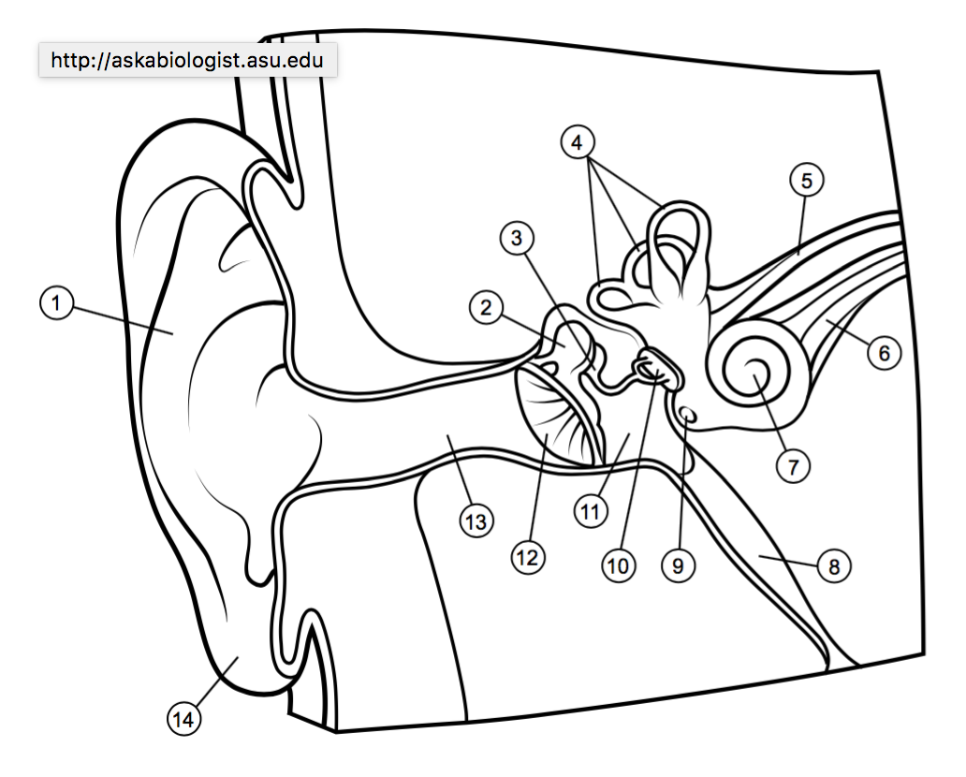

Slide 8
DETECTING SOUNDS
Pinna
Sound is directed into the canal
Ear canal
Ear drum (tympanic membrane)
Sound waves cause it to vibrate

Slide 9
Ossicles (3 tiny bones that are attached: hammer, anvil, stirrup/stapes)
-Amplify the sound

Slide 10
Semicircular ducts
filled with fluid and send information on balance
Cochlea
Contain hair cells which are mechanoreceptors that transform sound into impulses

Slide 11
Auditory nerve
Send impulses to brain

Slide 12
HOW DO WE HEAR PARAGRAPH
Sound waves directed in ear canal by the pinna. The sound waves vibrate the ear drum. The three ossicles (hammer, anvil and stirrup/stapes) will amplify the sound. The semicircular ducts send information about balance. The cochlea has mechanoreceptors which detect and changes sound waves into impulses. Lastly, the auditory nerve send these impulses to the brain.

Slide 13

THE SKIN

Slide 14
THE SKIN
Thermoreceptor
Meissner’s Corpuscle
Nociceptor
Pacinian Corpuscle

